Slide 1

HCM Data Loader
By Kasi Viswanadh

Slide 2
Agenda
Introduction
Process Flow
Data Values
Keys
Advanced Data Loading
Date Effective Business Objects
Error Management
Assignment Exercise

Slide 3
Introduction

Slide 4
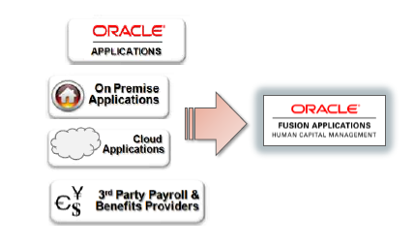
Data Loader
HCM Data Loader is a powerful tool for bulk-loading data from any source to Oracle Fusion HCM. (Flat File based bulk loading of data into Oracle HCM Cloud )
Supports important business objects belonging to Oracle Fusion HCM products
including Oracle Fusion Global Human Resources, Compensation, Absence Management, Performance Management, Profile Management, Global Payroll, Talent and Workforce Management.

Slide 5
Features
Suited for large volumes and Supports complex data objects with full date effective history
Can be used for loading historical data, hierarchical tree structure, DFF’s and EFF’s, documents, attachments, pictures as well.
Comprehensive User interface –user can initiate data load (Validates and loads the data) , monitor the process, load stages ,review the errors at both import and load(Support for Error Correction).
Feasibility to automate the data load, can be initiated through a web service call .
Loads all data files from the Oracle Web Center Content server, which provides a single point of entry to Oracle Fusion HCM.
HCM Data loader Supports Multithreaded Processing, which enables you to upload complete data extracts without severe performance impacts.

Slide 6
Job Roles that give access to HDL
Job Roles
Human Capital Management Application Administrator
Human Capital Management Integration Specialist
Duty Roles
HCM Data Load Duty
HCM Data Load Error Management Duty
File Import and Export Management Duty

Slide 7
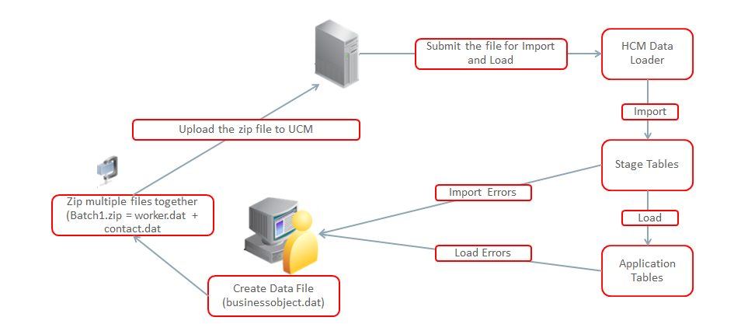
HCM Data Loader - Data Flow

Slide 8
Comprehensive Bulk Loading Capabilities
Business Object support across the product family
Bulk loading of:
  Flex field Data
  Person Images
  Documents of Record Attachments
  Translation Data
  Department and Organization hierarchies

Slide 9
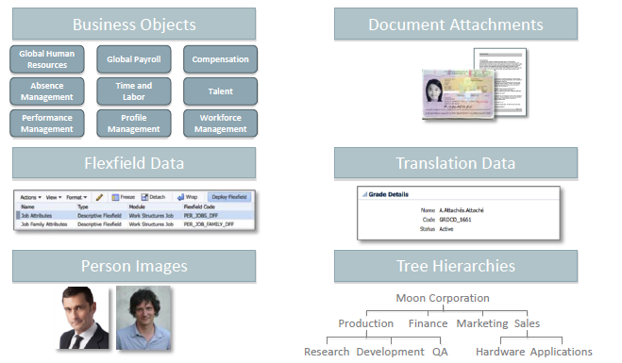
Comprehensive Bulk Loading Capabilities

Slide 10
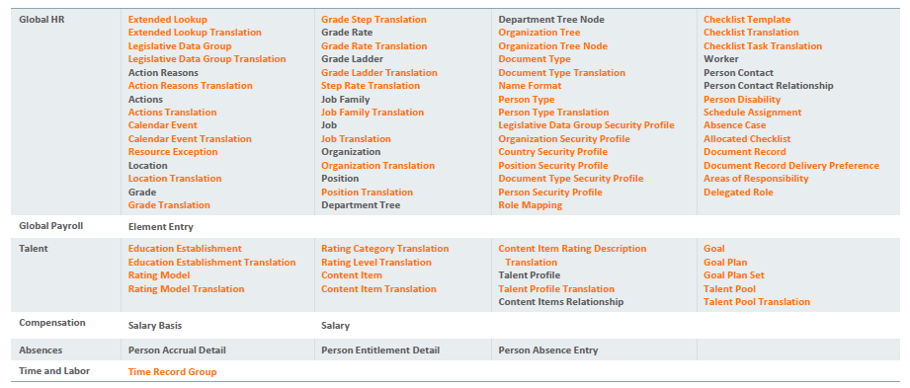
HCM Data Loader Supported Business Objects

Slide 11
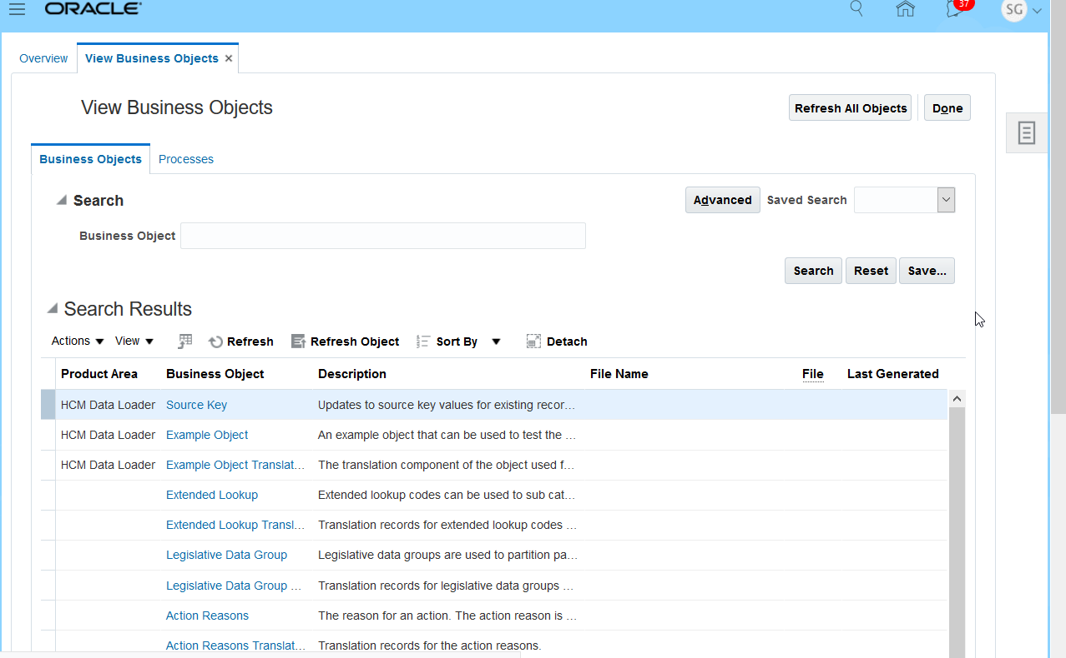
Reviewing Supported Business Objects

Slide 12
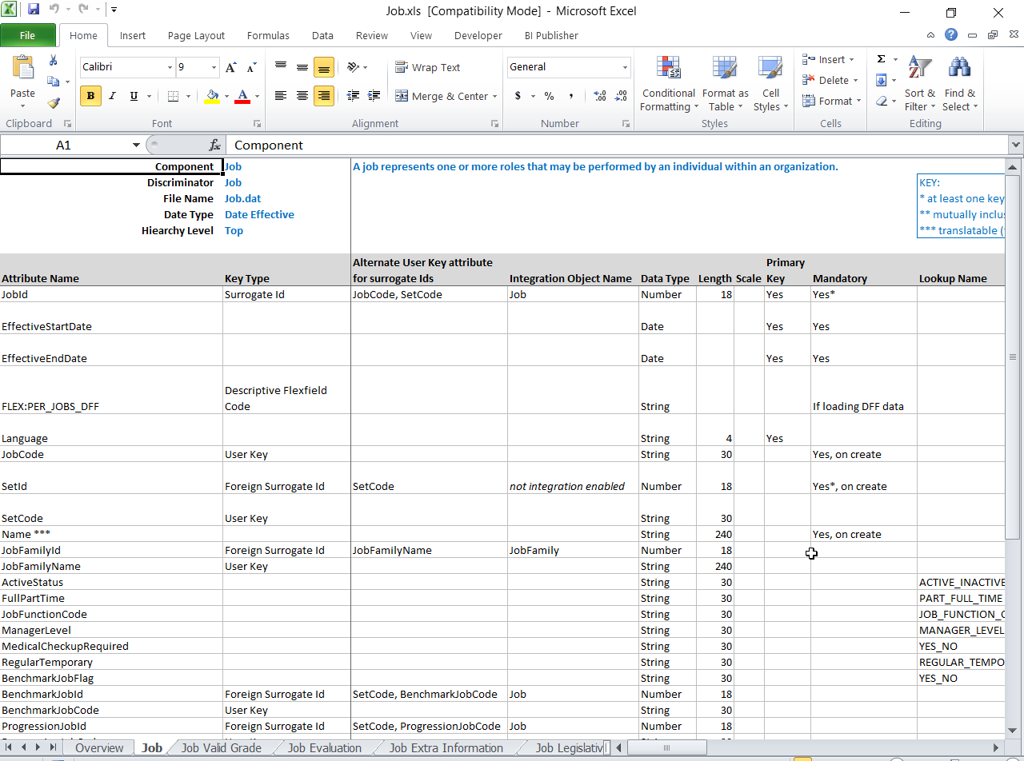
Business Object Spreadsheets
Documents the attributes available for each component of the object hierarchy
Includes
  Key Type
  Alternate User Key
  Data Type
  Length
  Primary Key
  Lookup Name
  Description
Notes:
HCM Data Loader: Business Object Documentation (Doc ID 2020600.1)

Slide 13
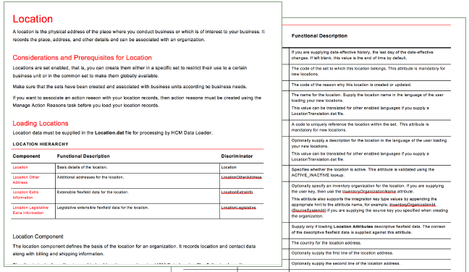
White Papers
Provide business object specific
guidance for bulk loading:
Considerations and Prerequisites
Loading guidelines
Common errors
Deletion Support
Loading translation data

Slide 14
Process Flow

Slide 15
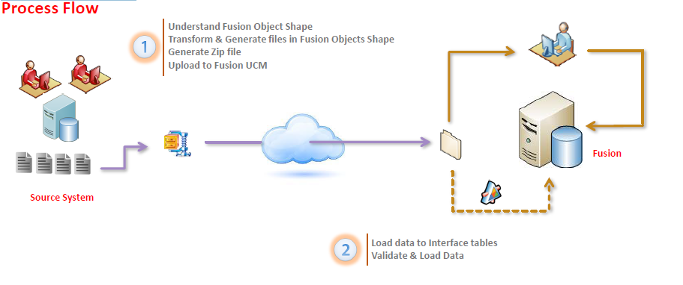
Data Loader Process Flow

Slide 16
File Format
Parent Child Component (1st level, 2nd level,3rd level and so on)
Pipe Delimiter
File Shape & File Structure (.dat + zip)
Data Line Structure

Slide 17
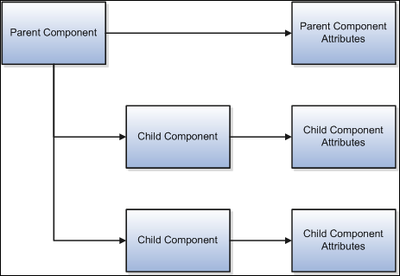
Understanding the Business Object Shape
Business Object Hierarchies
Hierarchical shape of business object components
Supports
  Multiple child occurrences
  Ability to load child components independently

Slide 18
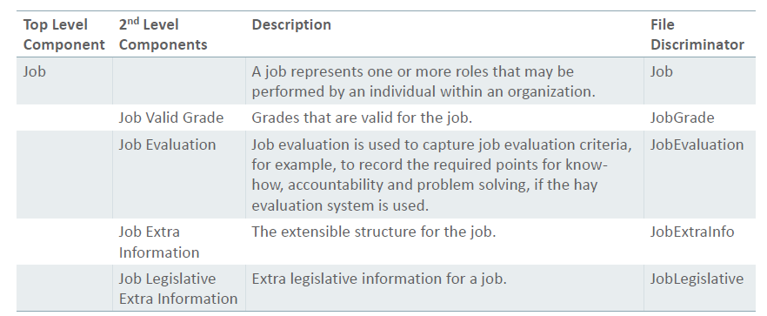
Understanding the Business Object Shape: Job
Job Business Object Hierarchy

Slide 19
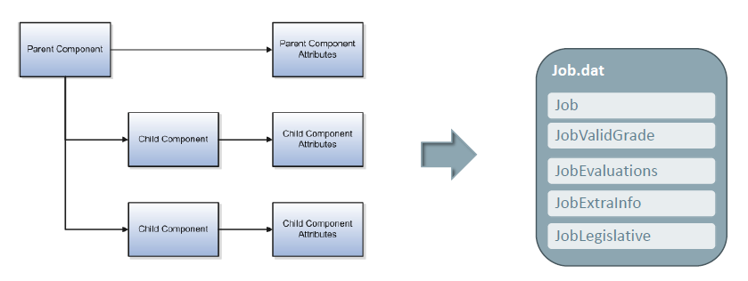
Understanding the Business Object Shape: Job
Business Object Hierarchy

Slide 20
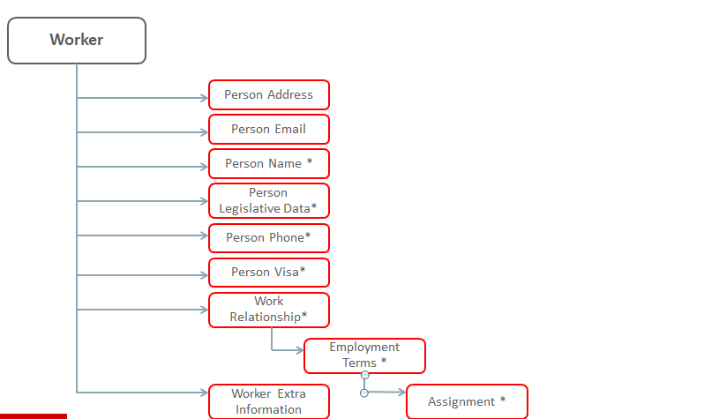
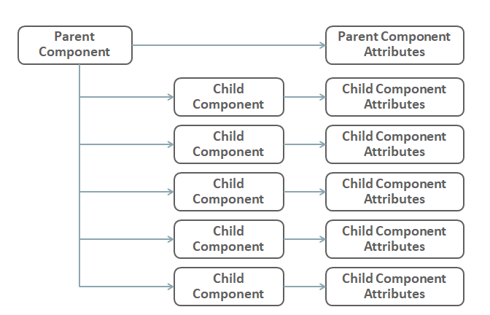
Business Object File Shape
Business Object Specific Files

Slide 21
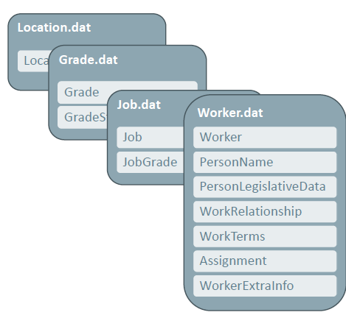
Business Object File Shape
Business Object Specific Files
One file per business object hierarchy
Pipe ‘|’ delimited
Only provide the components and attributes you use
Provide data in any order
Enforced naming convention

Slide 22
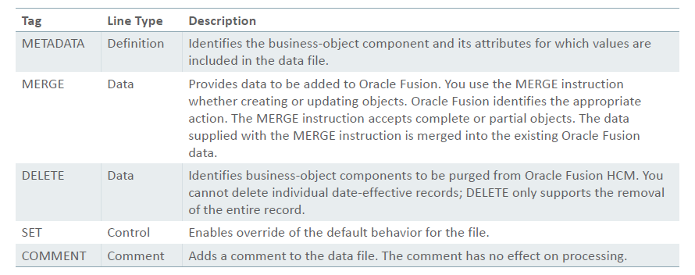
Supported File Line Instructions

Slide 23
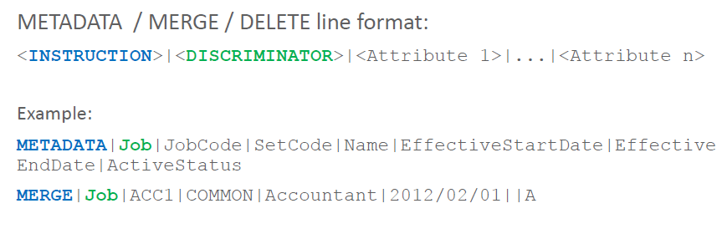
Definition and Data Line Structure

Slide 24
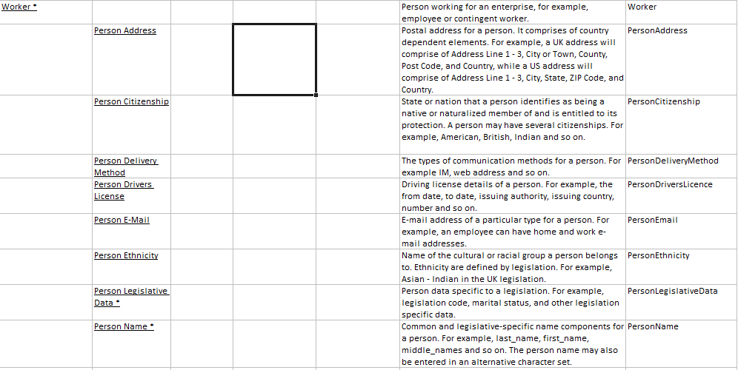
File Discriminators
Worker
Worker
Person Address
PersonAddress
Person Citizenship
PersonCitizenship

Slide 25
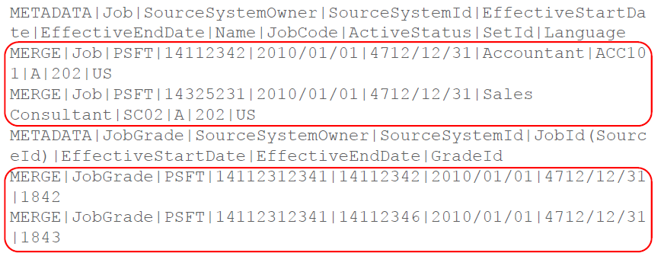
Data Lines

Slide 26
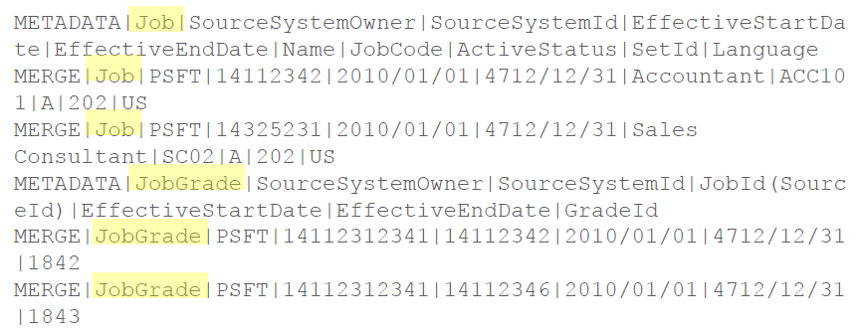
File Discriminators
Component Reference

Slide 27
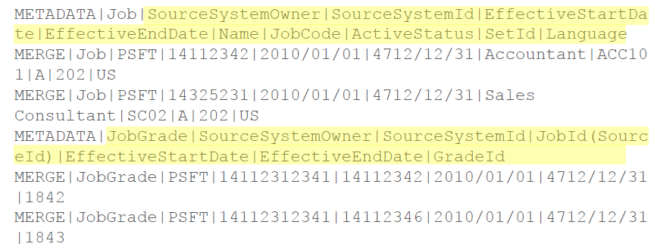
Define Attributes

Slide 28
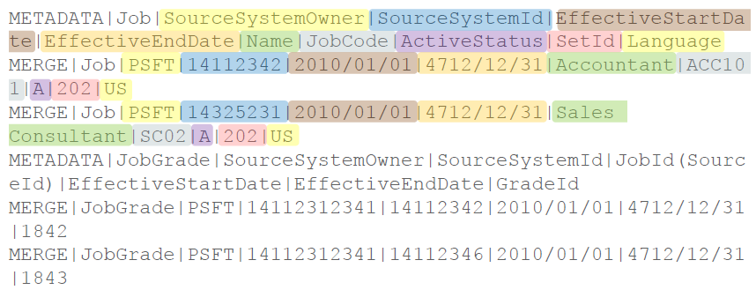
Attribute Order

Slide 29
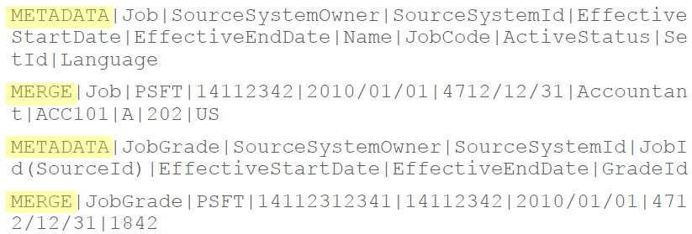
File Line Instructions

Slide 30
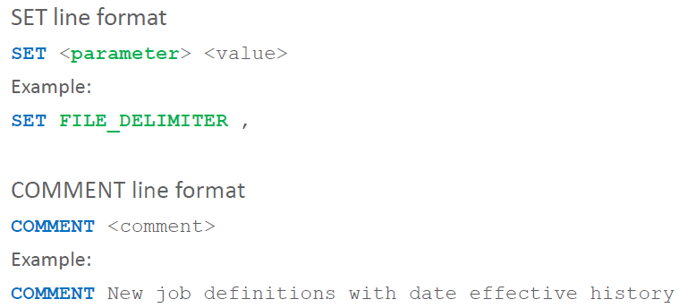
SET and COMMENT Line Structure

Slide 31
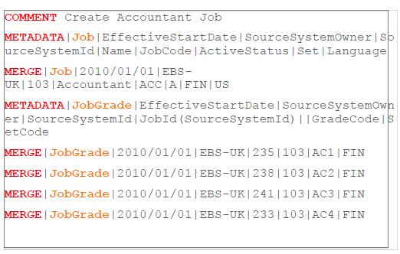
Business Object ‘dat’ File Format
Named for the hierarchy it contains data for, for example Job.dat, Location.dat, Worker.dat
Pipe-delimited
Each line starts with an instruction
Definition and data lines contain a component discriminator
Flexible to use & understand

Slide 32
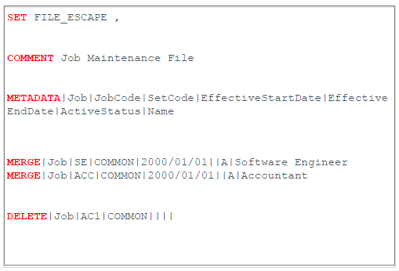
Dat File Instructions
SET
Override default behavior.
COMMENT
Ignored, for user readability.
METADATA
Defines components and attributes included in the file. Remove attribute names if not supplying values.
MERGE
Unique identifier for the record being maintained along with values to be added to Oracle Fusion.
DELETE
Unique identifier for the record to be deleted.

Slide 33
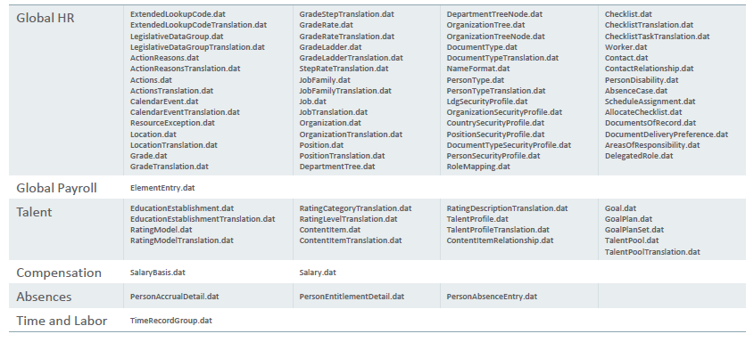
Supported Business Object File Names

Slide 34

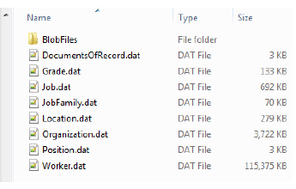
Zip File Structure
User defined name
One or more business object ‘dat’ files
Attachments/images delivered in a sub-folder
Business object ‘dat’ files are imported into stage in parallel.
Business object data is loaded in order of dependency

Slide 35
Data Values

Slide 36
Data Values
Number, Date and Time Formats
Reserved Characters
Retaining Existing Values
Lookup Attributes

Slide 37
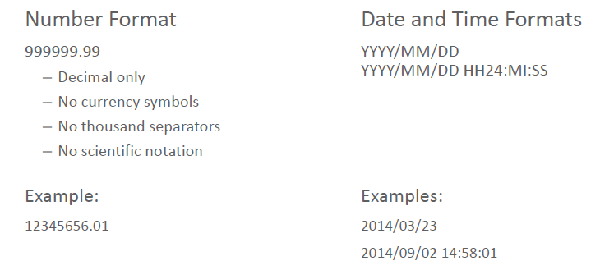
Number, Date and Time Formats

Slide 38
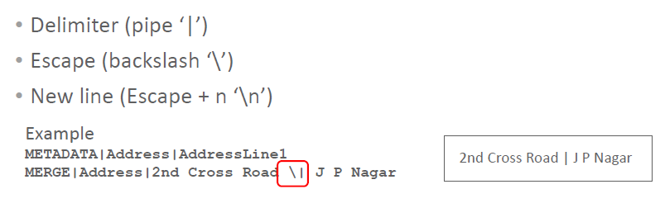
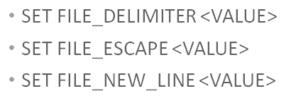
Reserved Characters – File Delimiter
Using the File Delimiter within an Attribute Value

Slide 39
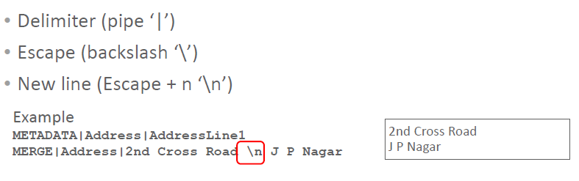
Reserved Characters – New Line
Specifying a New Line within an Attribute Value

Slide 40
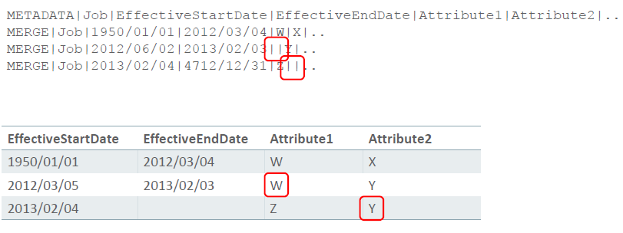
Retaining Existing Values
Unspecified Attributes

Slide 41
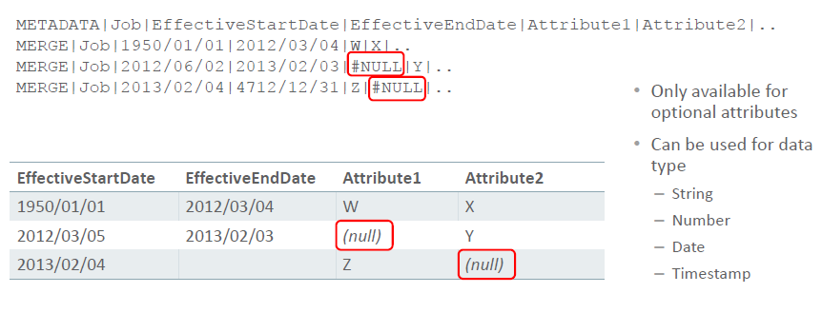
Setting Not Null Values to Null
#NULL Tag

Slide 42
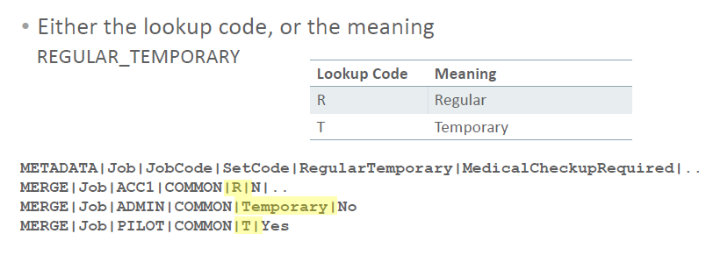
Lookup Validated Attributes

Slide 43
Keys

Slide 44
Keys
What are they?
Keys are used to uniquely identify
  The local business object component
  The parent of a business object component
  Any other object referenced by a business object component

Slide 45
HCM Data Loader Supported Keys
Source Keys
User Keys
Oracle Fusion Surrogate ID
Oracle Fusion GUID (Globally Unique Identifier)
Four Key Types Supported

Slide 46
Oracle Fusion GUID
Generated in Oracle Fusion when a record is created
Hexadecimal value
Unique across all objects
Held in Integration Key Map
Integration Key Generated by Fusion

Slide 47
Oracle Fusion Surrogate ID
Fusion generated unique ID
Generated in Oracle Fusion when the record is created
Numeric value
Unique only for the object type
Held against the object definition

Slide 48
Source Keys
Source System Key Information
Two values combined:
  SourceSystemOwner
  SourceSystemID
Held in Integration Key Map

Slide 49
User Keys
User Readable and Generated Keys
Natural values
One or many attributes
Sometimes alternatives

Slide 50
Key Resolution Sequence
Source Keys
User Key
Oracle Fusion Surrogate ID
Oracle Fusion GUID

Slide 51
Classification of Keys based on storage location
Integration Key Map table
Oracle Fusion GUID
Source System ID
Belonging Object – Application Table
Oracle Fusion Surrogate ID
User Key

Slide 52
Key Generation on Data Load
Load Worker data
Creates 1 record in Application table
Person ID
Person Number
Creates 1 record in Integration Key Map table
GUID
SSID

Slide 53
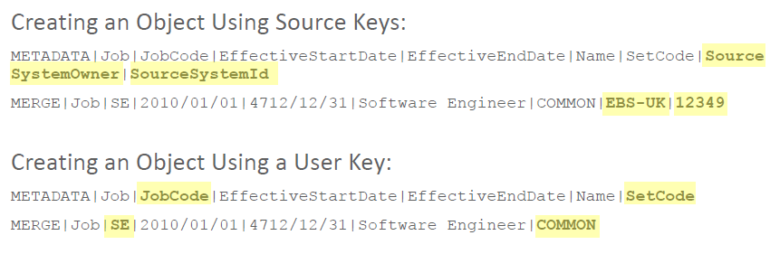
Using Keys when CREATING objects
Source System Key and User Keys

Slide 54
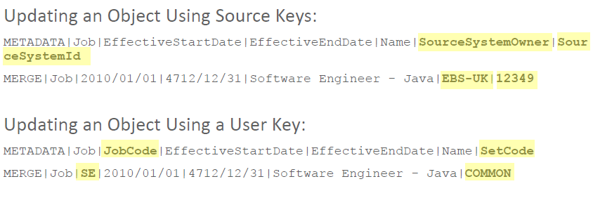
Using Keys when UPDATING objects
Source System Key and User Keys

Slide 55
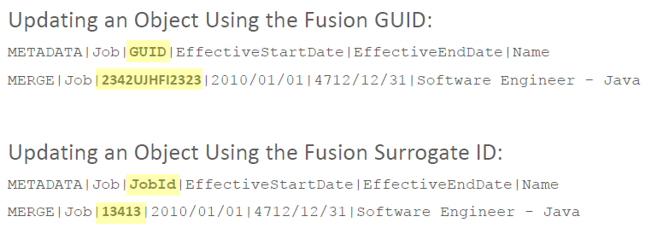
Using Keys when UPDATING objects
Fusion GUID and Fusion Surrogate Key

Slide 56
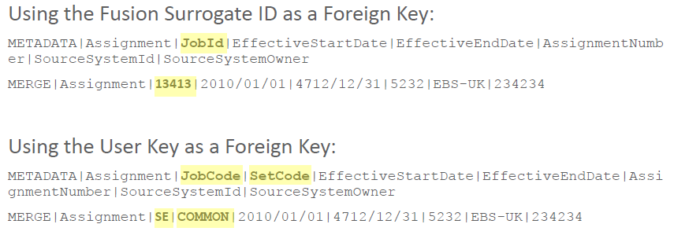
Specifying Foreign Keys

Slide 57
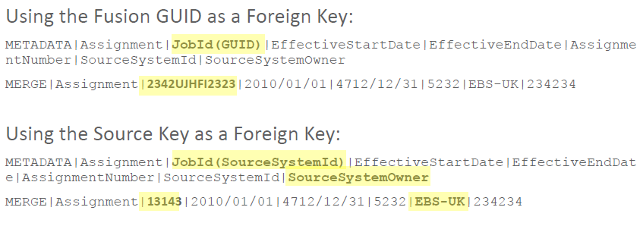
Specifying Foreign Key Hints
Integration Keys supplied using hints

Slide 58
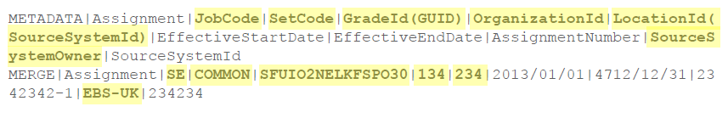
Supplying Key Attributes Example
Using All Key Types

Slide 59
Advance Data Loading

Slide 60
Advanced Data Loading
Flex fields
Attachments
Person Images

Slide 61
Flex field Types
DFFs and EFFs
HCM Data Loader supports the bulk loading of flex field attributes:
Descriptive Flex Field
Extend the data model with additional attributes
Provides a set amount of segments for an entity
Extensible Flex Field
Similar to DFF but the number of segments are not fixed.
Key Flex Field
Not included in the scope of HDL

Slide 62
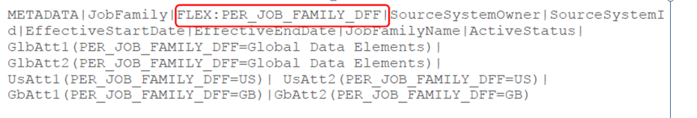
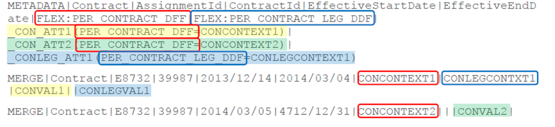
Descriptive Flexfield Code
Single FF
Multiple FF

Slide 63
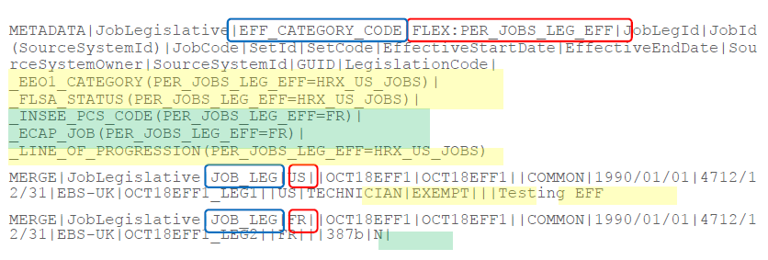
Extensible Flexfield Context

Slide 64
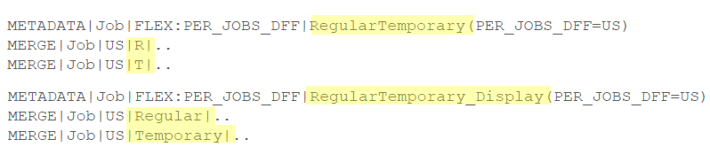
Lookup Validated Flexfield Attributes
Attributes
Two separate attribute names required in METADATA
  Template file attribute name: Lookup Code only
  Add _Display to the name: Meaning only

Slide 65
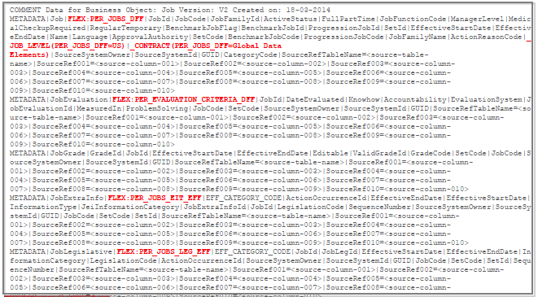
Supplying Flexfield Data
Summary

Slide 66
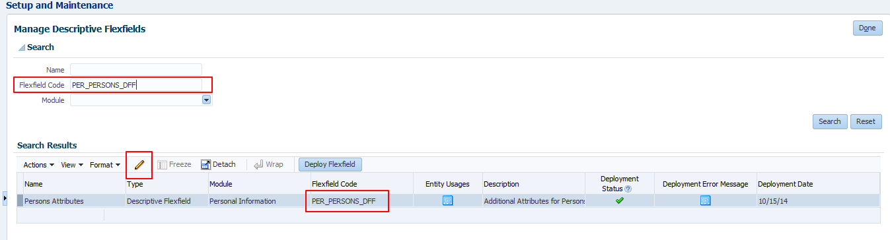
Supplying Flexfield Data
Setups in UI

Slide 67
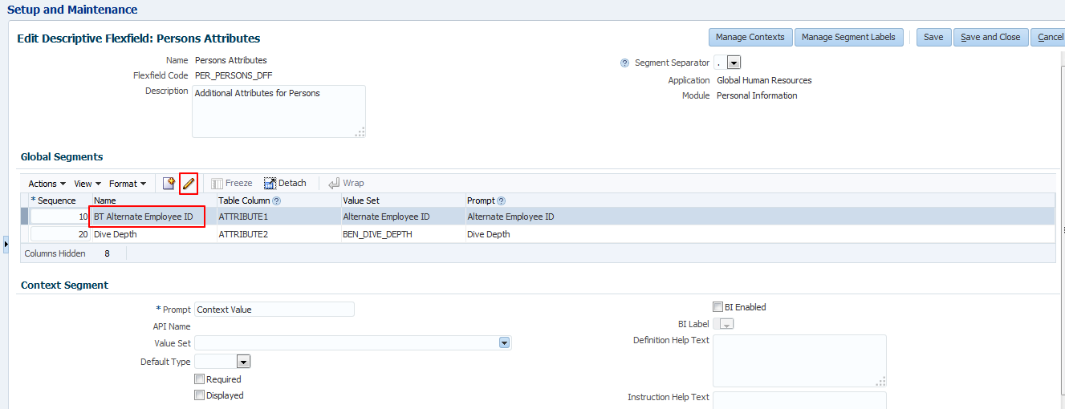
Supplying Flexfield Data
Flex field Attributes in UI

Slide 68
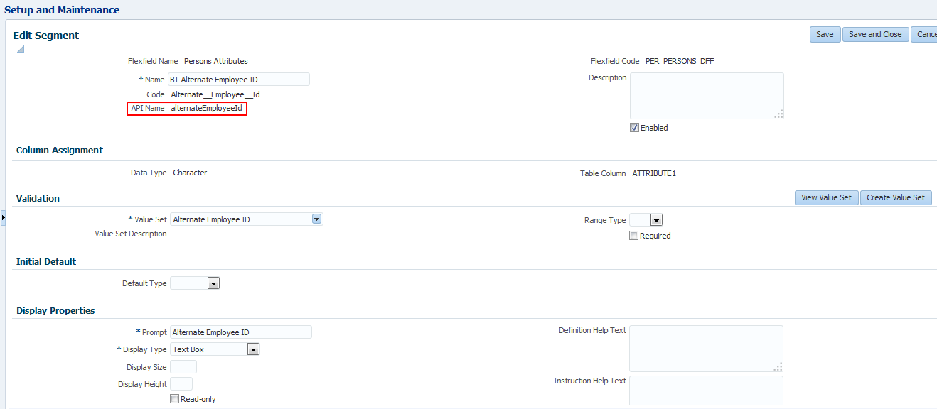
Supplying Flexfield Data
Flex field Segments in UI

Slide 69
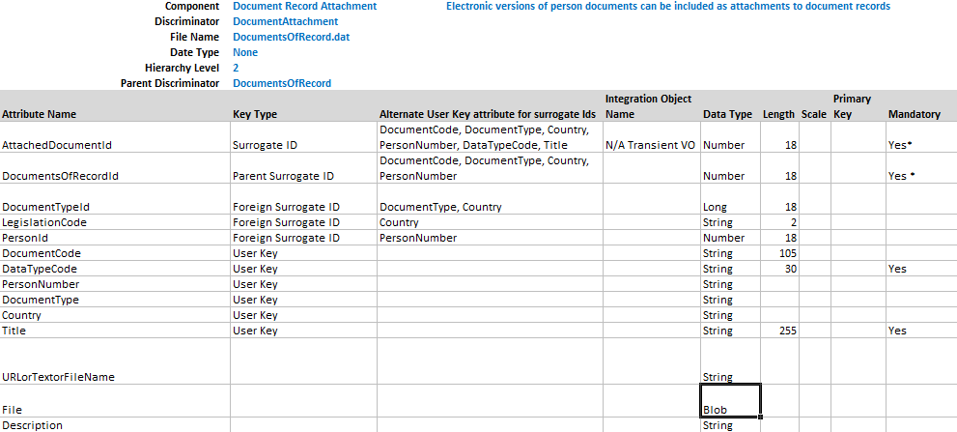
Attachment & Large Objects

Slide 70

Attachment & Large Objects
Data-type-specific folder within the zip file:
  BlobFiles
  ClobFiles

Slide 71
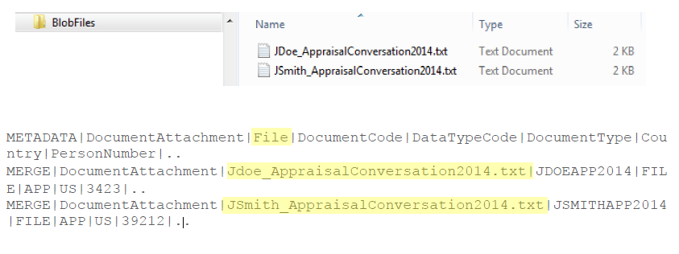
Attachment & Large Objects

Slide 72

Person Images

Slide 73
Date Effective Business Objects

Slide 74

Date Effective Attributes
Attributes

Slide 75
Rules for Supplying Date-Effective and MCPD History
New Objects
No gaps in the date effective history.
The unique key is identical over all date effective records.
The EffectiveSequence starts at 1 for all new effective start dates and is sequential for matching effective start dates.
The EffectiveLatestChange is always N when the record is not the latest change for an effective start date and Y when it is.
The EffectiveEndDate matches the EffectiveStartDate when the MCPD record is not the latest change for an effective start date.

Slide 76

Date Effective Attributes
Attributes

Slide 77

Rules for Supplying Date-Effective and MCPD History

Slide 78
Error Management

Slide 79

HCM Data Loader
Data Set Errors

Slide 80

HCM Data Loader
Data Set Errors

Slide 81


HCM Data Loader
Data Set Errors

Slide 82

HCM Data Loader
Debugging & Diagnostics

Slide 83

Record Counts

Slide 84

Reviewing Messages
Review summary of messages raised
Number of occurrences of each message provided
Message summary can be extracted to spreadsheet

Slide 85
Q&A

Slide 86
Thank You!

Slide 87


